Slide 1
Creating a file sync and backup system
Quincy Day, Devin Young, Keith Gibson

Slide 2
Server hardware requirements
Fedora Server 40
50GB of Disk Space
5GB of RAM
2GHZ 64-bit processor

Slide 3
Importance of Backups
Backups are important because there's always a chance of your data being corrupted, compromised, or lost.
Without backups, it would be harder to keep track of your data and businesses would lose their value, credibility, etc.
Scripts that create and maintain backups are essential to the success of any business or individual with important data.
Since we are backing up files using the cloud, it will be easier to keep track of files that have been updated/altered, as well as backtrack if a circumstance calls for it.

Slide 4
Function of our File Sync & Backup System
Full backups at 12:00 A.M. on Monday (every week)
Incremental backups will be performed at 12:00 A.M. , Tuesday – Sunday (every
week).
Retention policy that includes the last full backup of every month being retained for 365 days, and every other backup (incremental or full backup) being retained for 30 days.
The script for the retention policy will be ran daily.
Monitoring of the various backups, with the backups themselves and the monitoring of the backups being automated through scripts and cron jobs

Slide 5
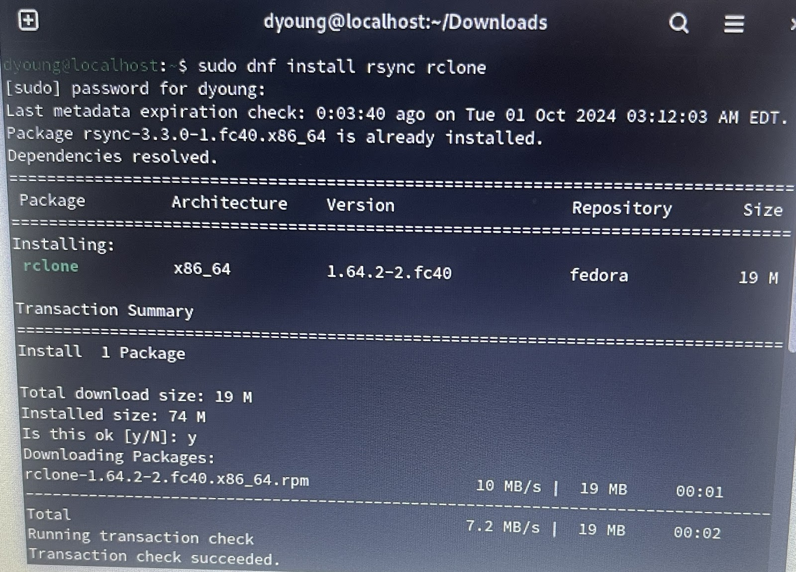
Backup Destination
Install rsync and rclone packages

Slide 6
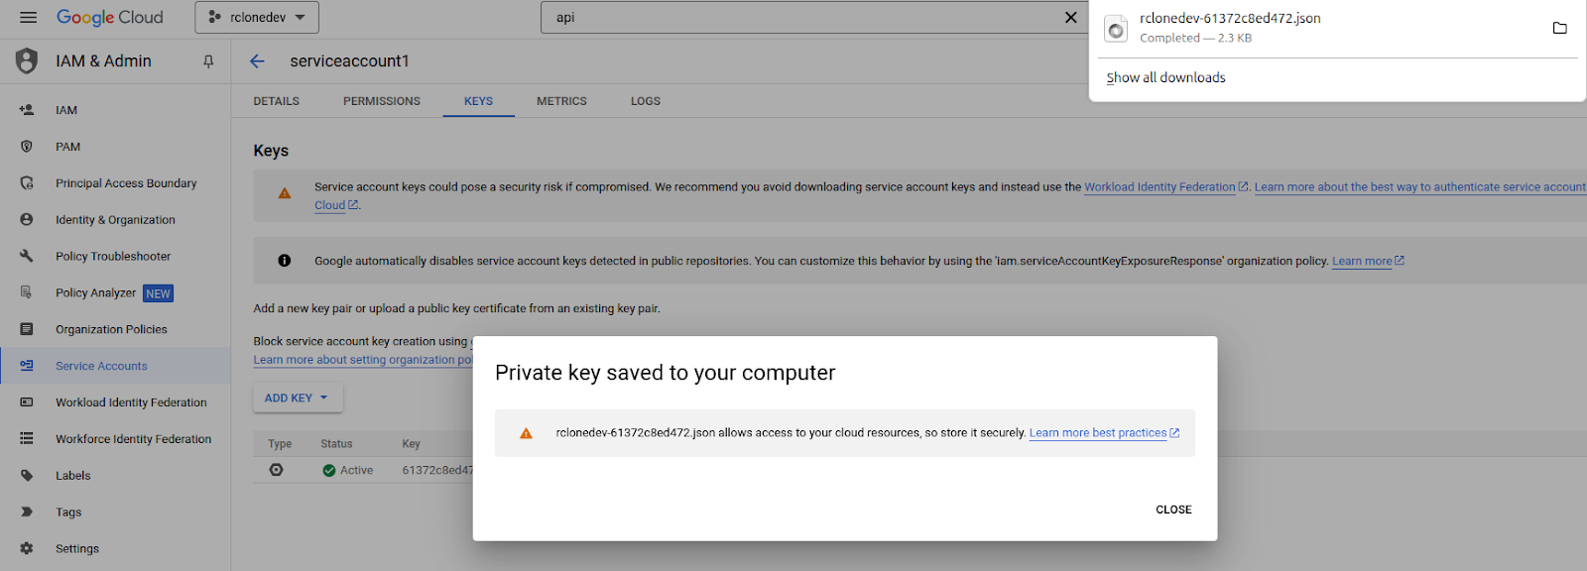
Backup destination Cont.
Create a service account through the google cloud console

Slide 7
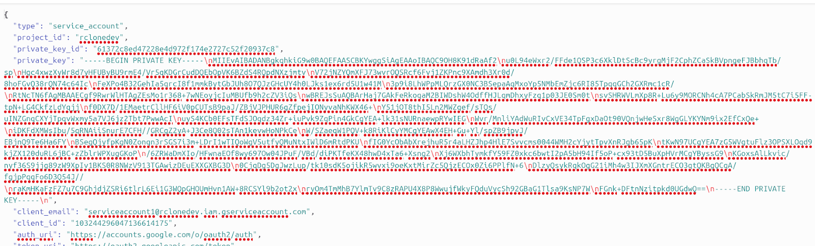
Backup destination Cont.
Create a key (JSON) and open it to retrieve the client_email

Slide 8
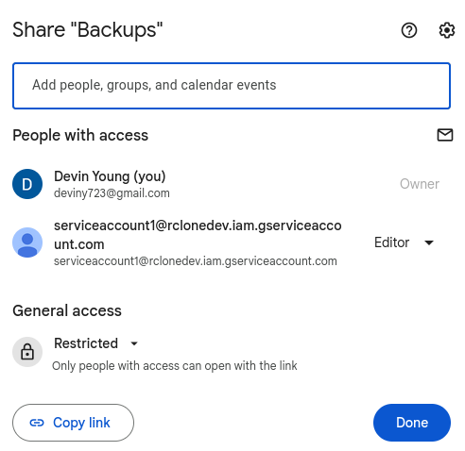
Backup Destination Cont.
Share the backups folder in Google Drive with the service account we created so that our backups can go to the cloud as well.

Slide 9
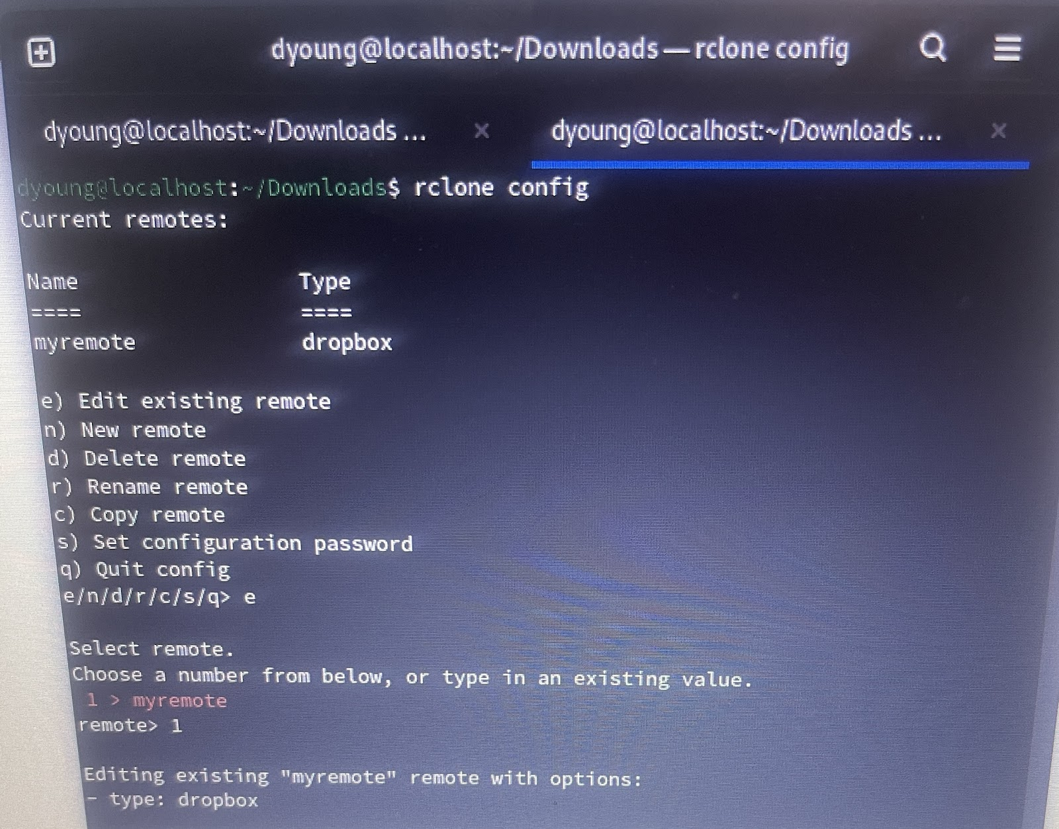
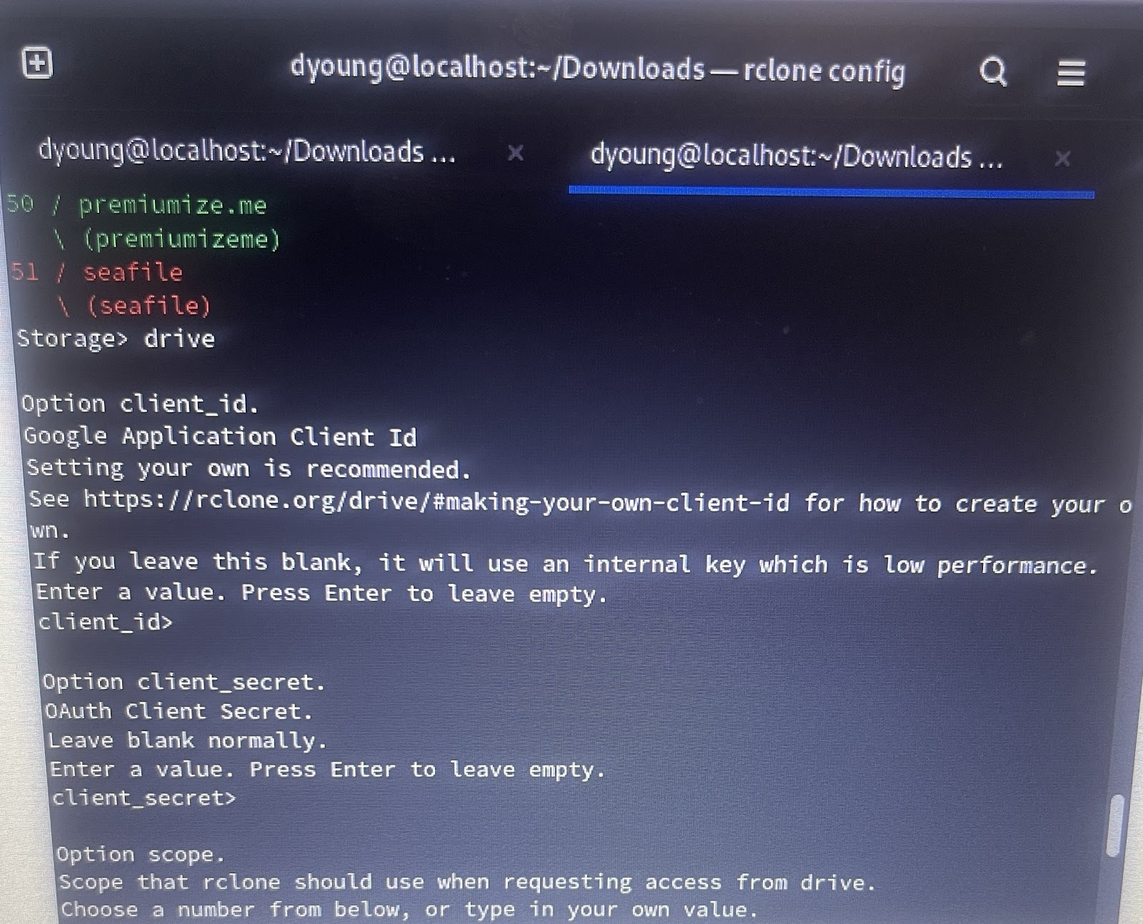
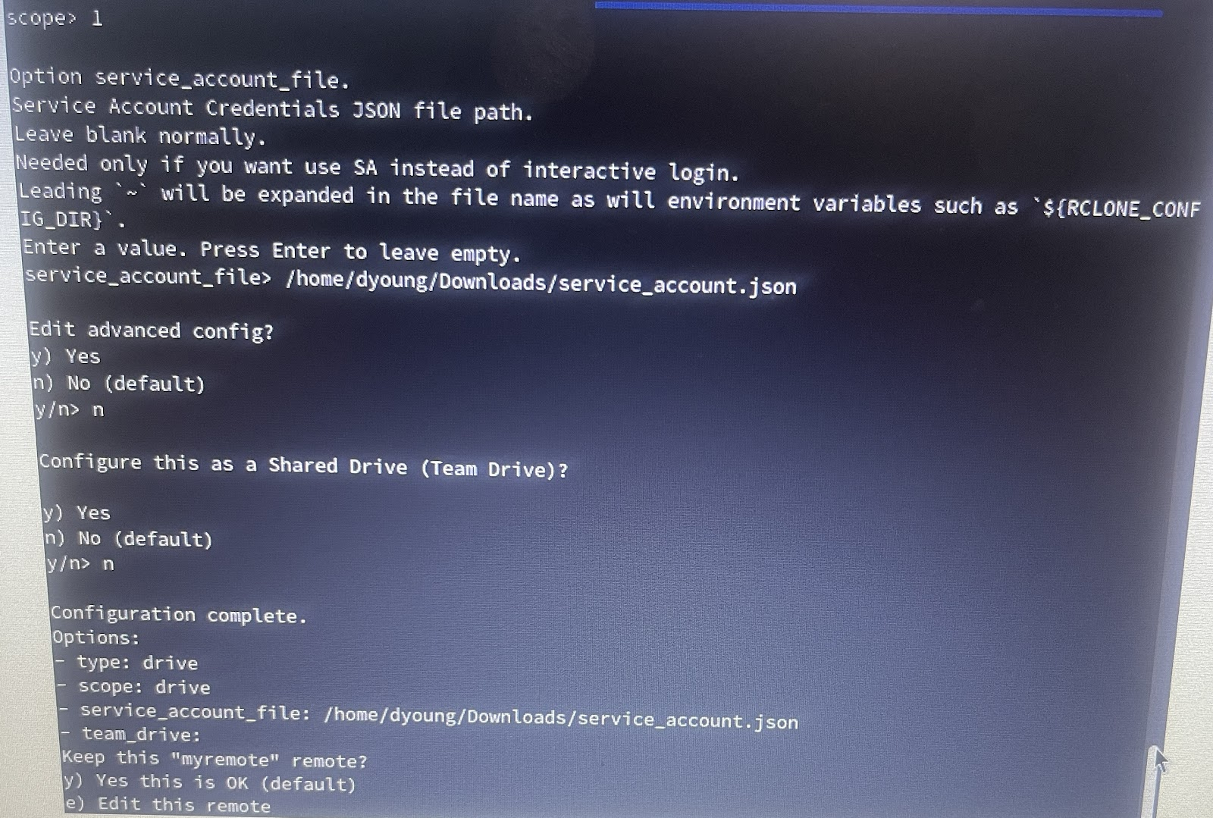
Backup Destination Cont.
Configuring rclone to manage files on cloud storage

Slide 10
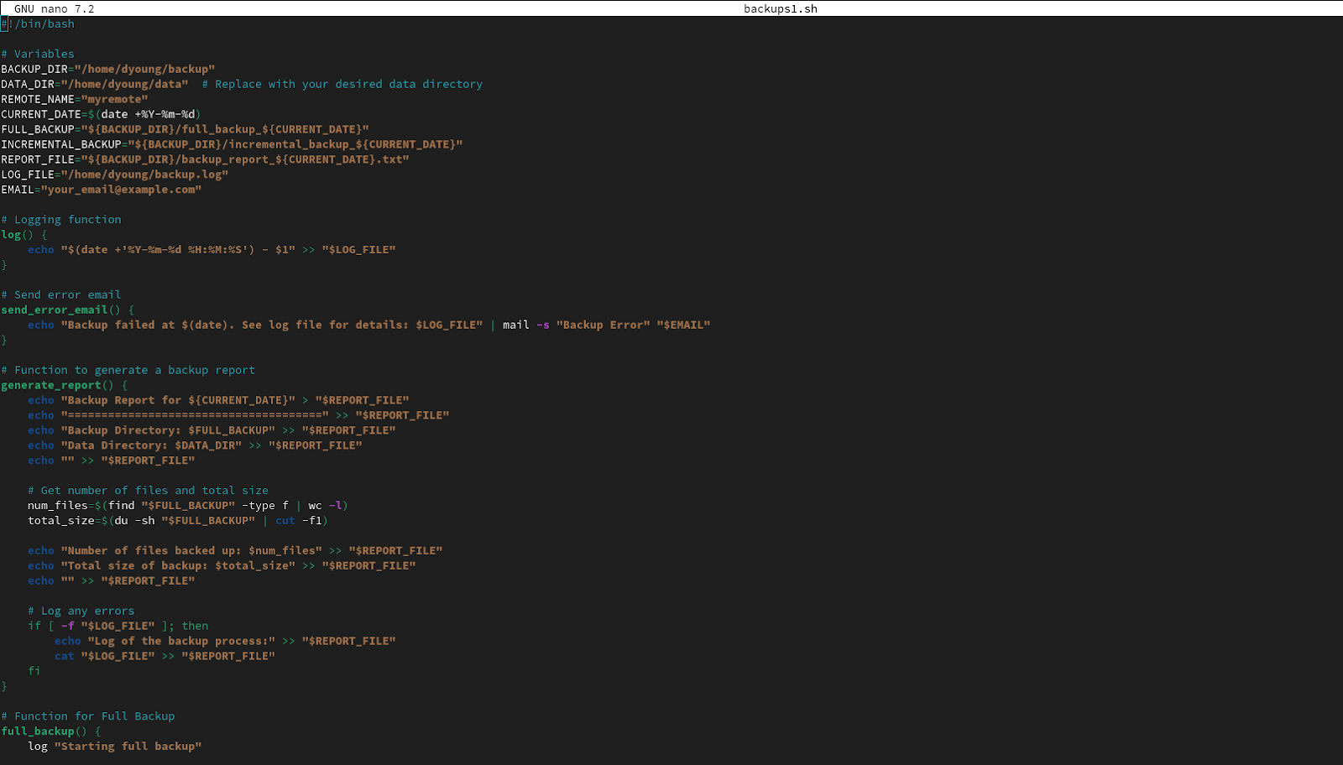
Backup script + Retention Policy

Slide 11
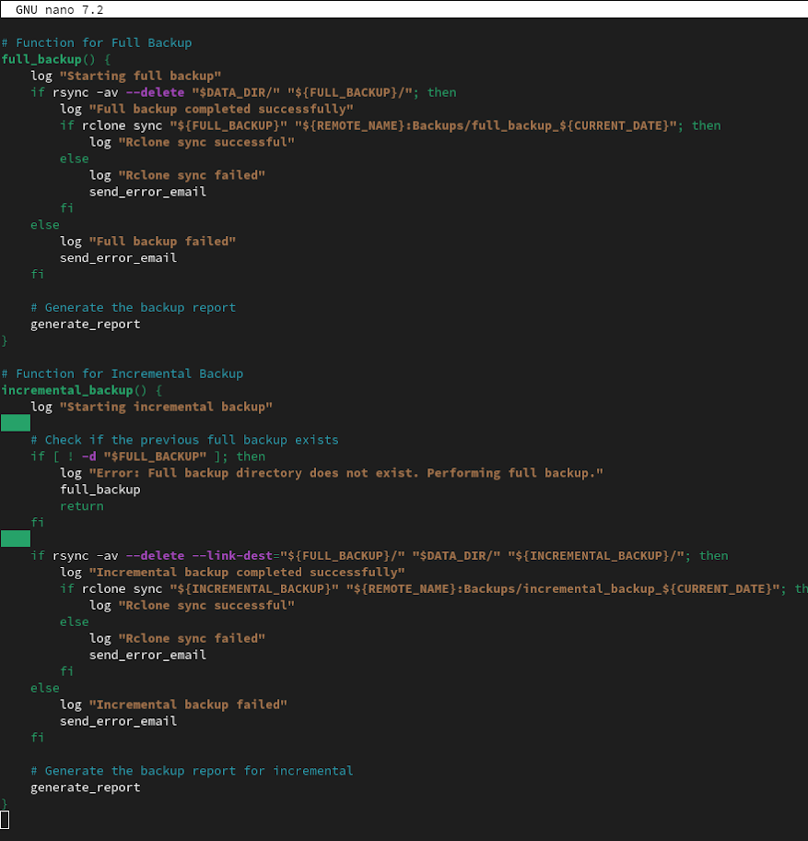
Backup Script & Retention Policy (II)

Slide 12
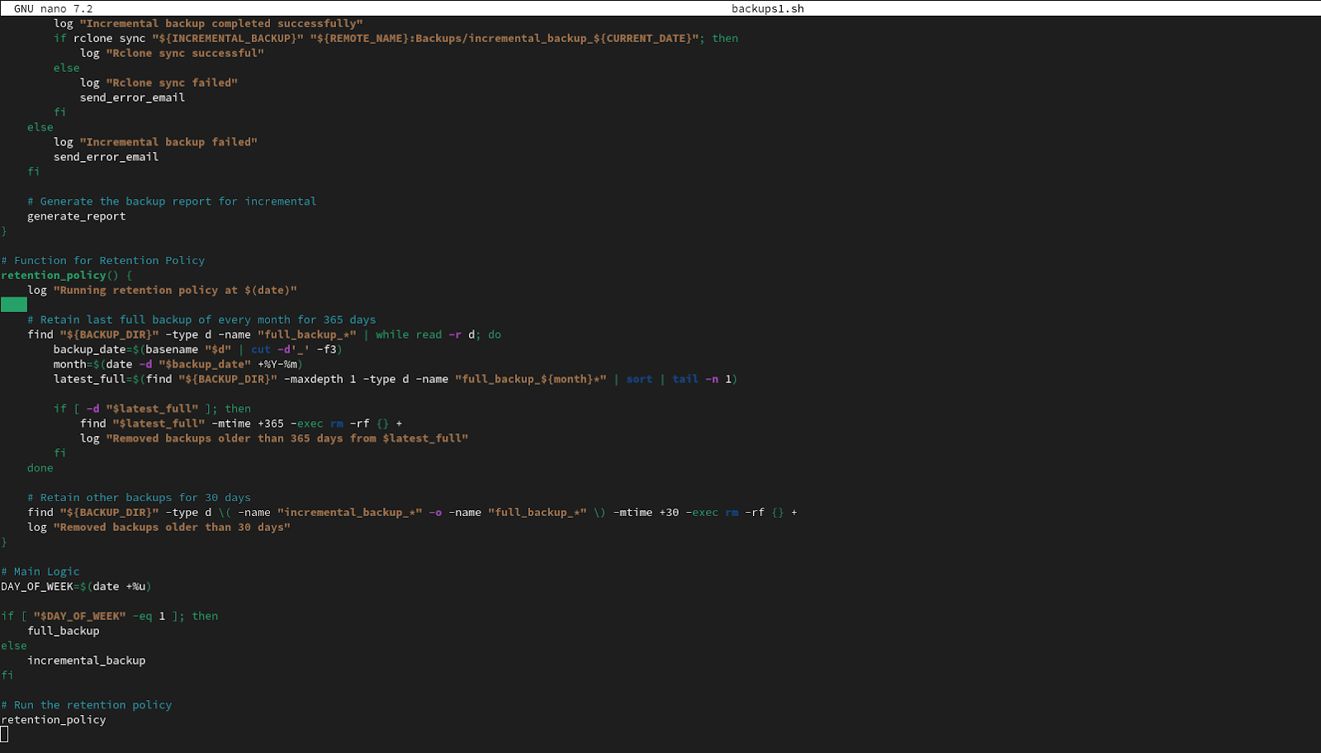
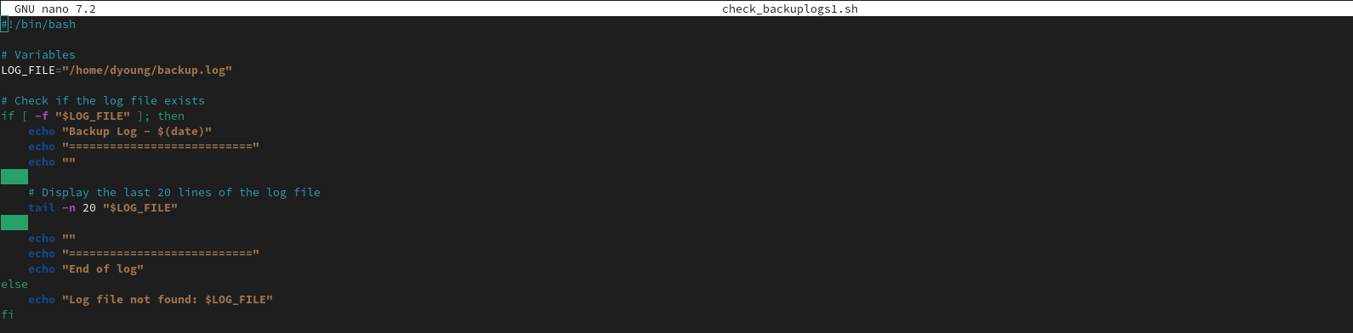
Backup Script & Retention Policy (III)
Script to Monitor Backups

Slide 13
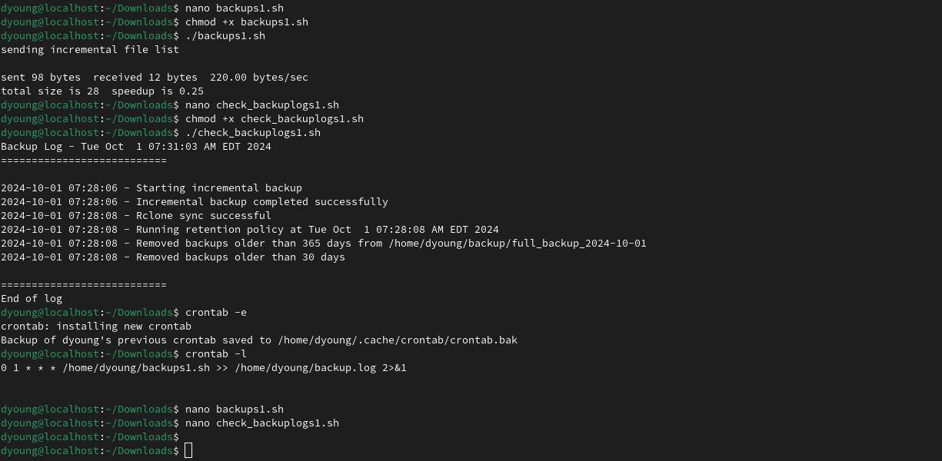
Backup Script & Log Monitoring Tests
Verifying that all scripts function properly

Slide 14
Implementing cron
Using crontab to automate backups

Slide 15
Disaster Recovery Plan
We will have multiple off-premise cloud environments in place as backups for original data and backups that we created.
This way, if our original data or backups are corrupted or compromised, we'll still have all of our data.
More specifically, we would repeat the process we demonstrated here in our presentation so that we can recover from any disaster.

